Slide 1
ML IN HEALTHCARE
White blood cells classification
Manon Chossegros
manon.chossegros@sorbonne-universite.fr

Slide 2
SUMMARY
Presentation of the data
Presentation of the features
Machine Learning models
Improve the models
Medical interpretation

Slide 3

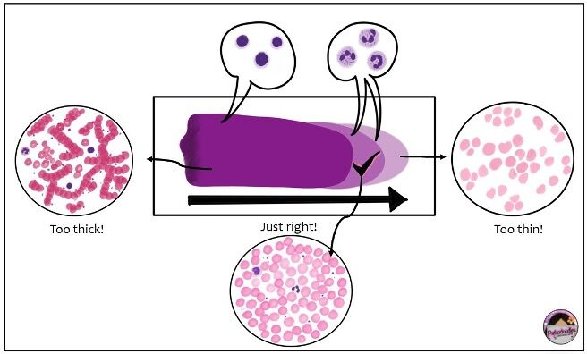
INTRODUCTION
The analysis of blood tests is performed by looking blood smears under a microscope

Slide 4
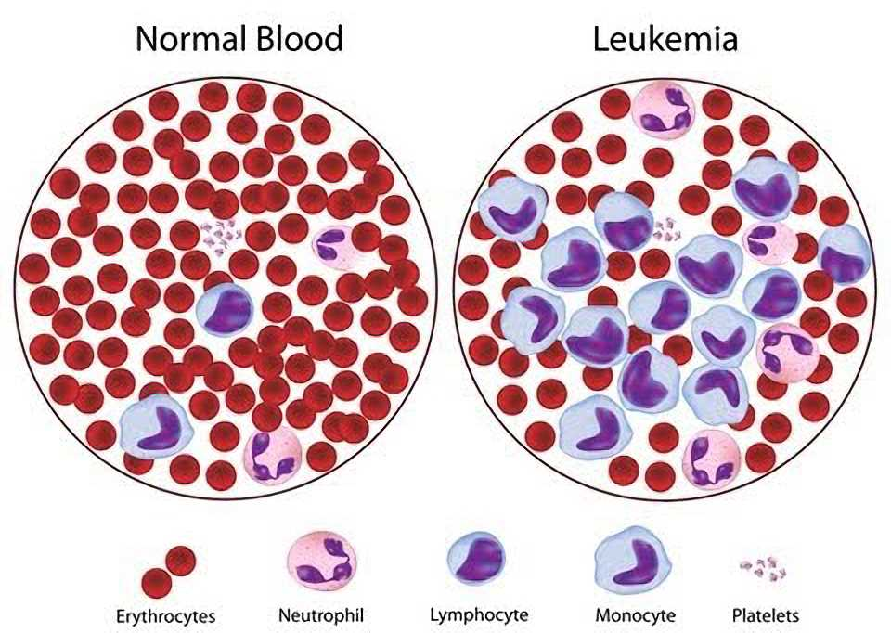
THE IMPORTANCE OF CELL CLASSES PROPORTION
The relative proportion of the different white blood cells categories indicates the presence or not of a pathology

Slide 5
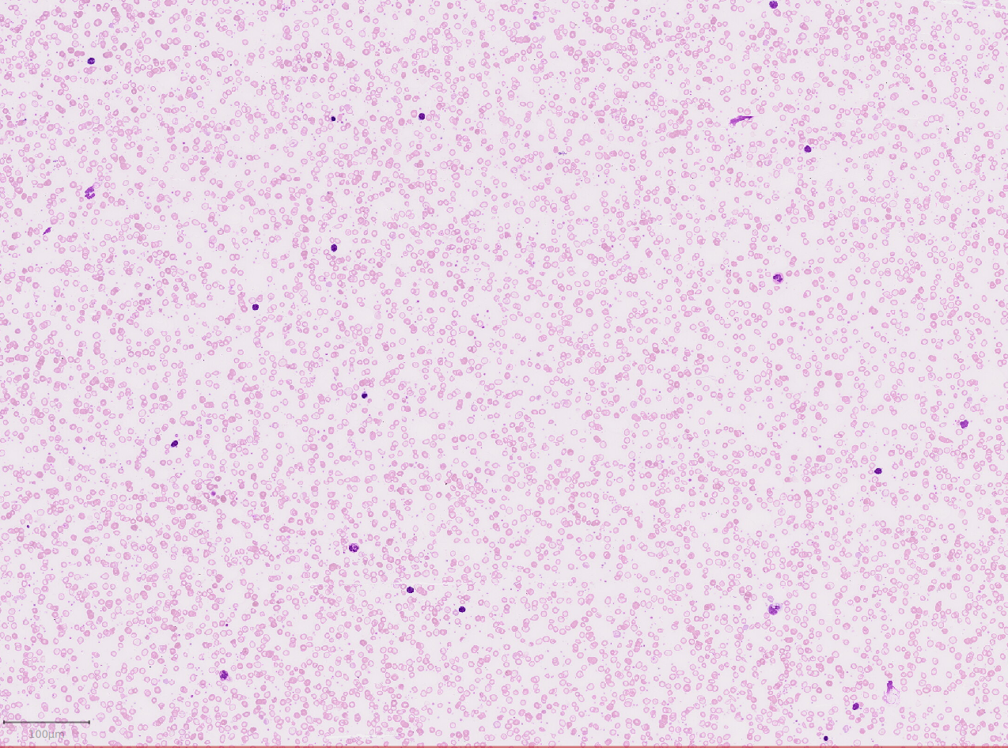
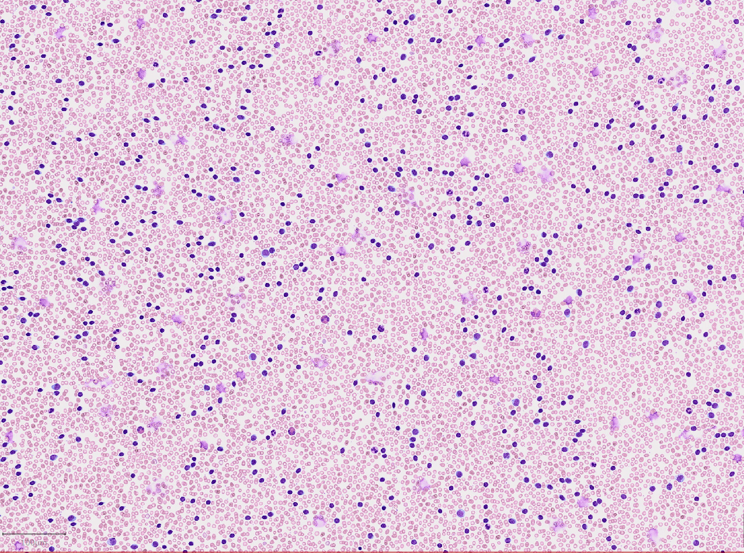
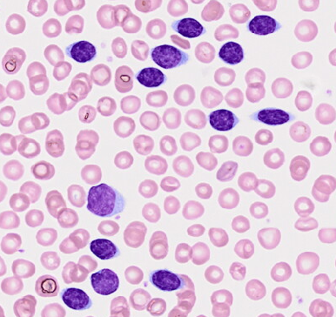
ON REAL DATA
Lymphocyte invasion is characteristic of leukemia
Healthy
Leukemia (clones of cancerous cells)

Slide 6
OUR DATASET

Slide 7
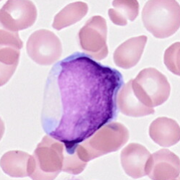
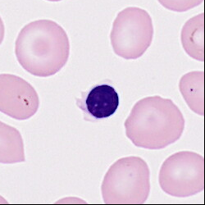
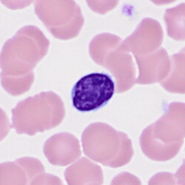
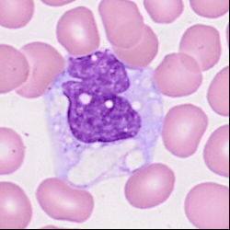
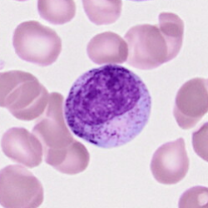
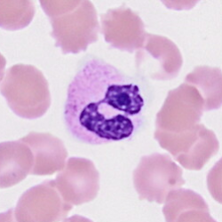
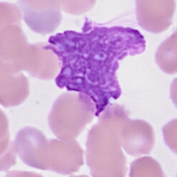
DIFFERENT TYPES OF CELLS
Blaste
Erythroblaste
Lymphocyte
Monocyte
Metamyelocyte
Neutrophile
Artefacte

Slide 8
THE FEATURES

Slide 9
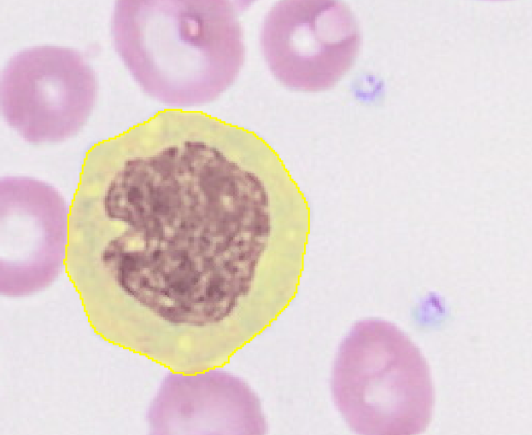
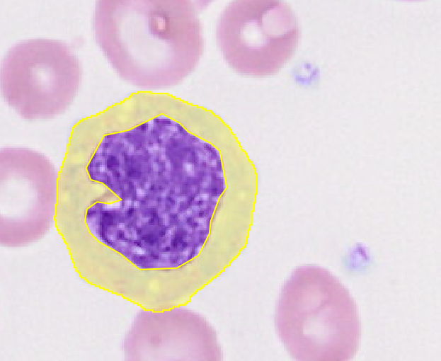
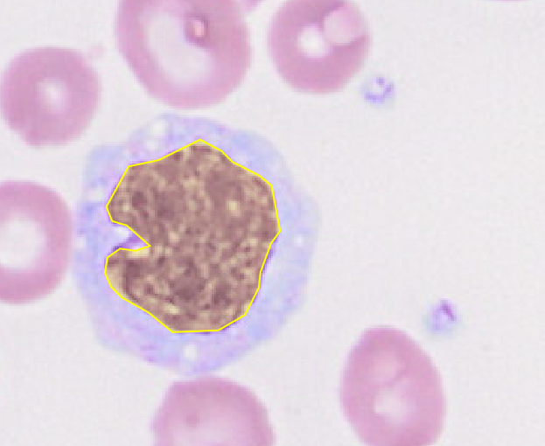
3 REGIONS OF INTEREST
Cyto
(full cell)
Cytoonly
(only cytoplasm)
Nucleus

Slide 10
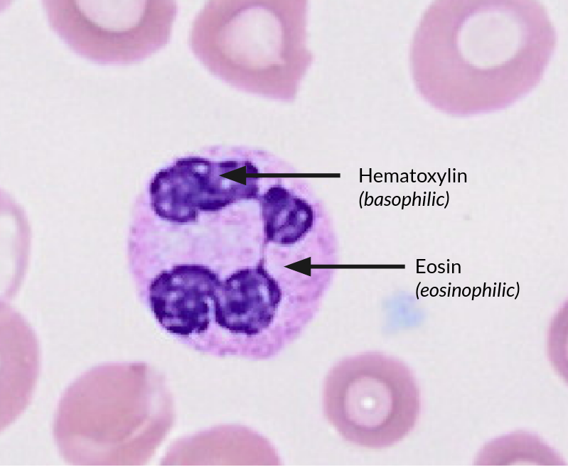
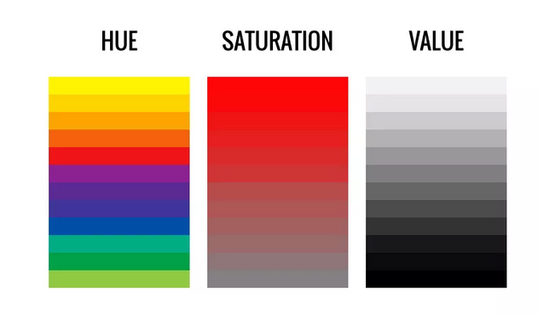
COLOUR FEATURES
2 coloring agents that stain:
Nucleus in blue
Cytoplasm in pink
Different ways to characterize a colour

Slide 11
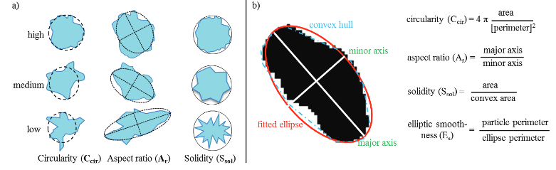
GEOMETRIC FEATURES

Slide 12
THE DATASET
Hematoxylin_Mean_nuclei Hematoxylin_Std_dev_nuclei Hematoxylin_Min_nuclei Hematoxylin_Max_nuclei Hematoxylin_Median_nuclei Eosin_Mean_nuclei Eosin_Std_dev_nuclei Eosin_Min_nuclei Eosin_Max_nuclei Hue_Mean_nuclei Saturation_Mean_nuclei Saturation_Std_dev_nuclei Saturation_Min_nuclei Saturation_Max_nuclei Saturation_Median_nuclei Eosin_Median_nuclei Area_µm^2_nuclei
Hematoxylin_Mean_cytoonly​​ Hematoxylin_Std_dev_cytoonly​​ Hematoxylin_Min_cytoonly​​ Hematoxylin_Max_cytoonly​​ Hematoxylin_Median_cytoonly​​ Eosin_Mean_cytoonly​​ Eosin_Std_dev_cytoonly​​ Eosin_Min_cytoonly​​ Eosin_Max_cytoonly​​ Hue_Mean_cytoonly​​ Saturation_Mean_cytoonly​​ Saturation_Std_dev_cytoonly​​ Saturation_Min_cytoonly​​ Saturation_Max_cytoonly​​ Saturation_Median_cytoonly​​ Eosin_Median_cytoonly​​ Area_µm^2_cytoonly
Length_µm_cyto
Circularity_cyto​ Solidity_cyto​ Max_diameter_µm_cyto​ Min_diameter_µm_cyto​ Perimeter_µm_cyto​

Slide 13
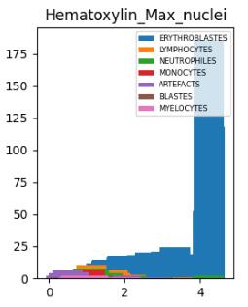
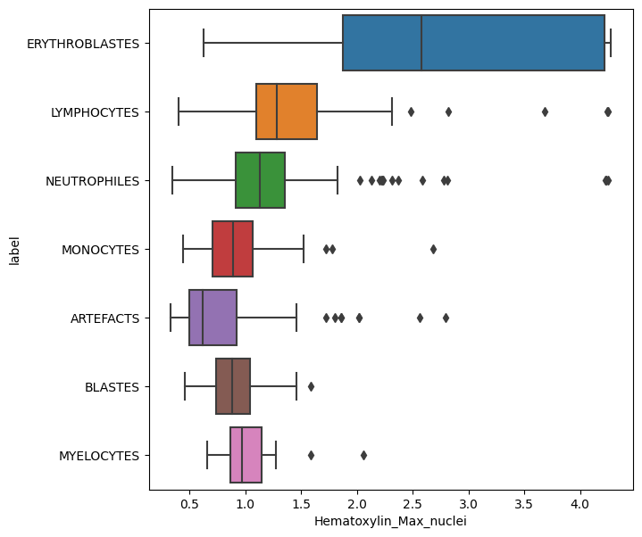
REPARTITION OF THE CLASSES WITH FEATURES

Slide 14
TRAINING MODELS

Slide 15
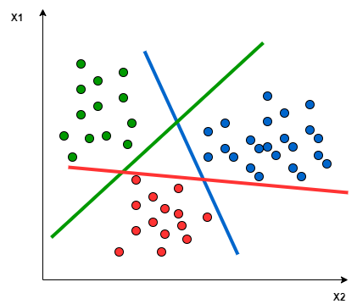
SVM
Goal: find the best boundary to delineate the regions of space

Slide 16

RANDOM FOREST
Goal: find the best decision trees to obtain a majority of good results

Slide 17
EVALUATION METRICS

Slide 18
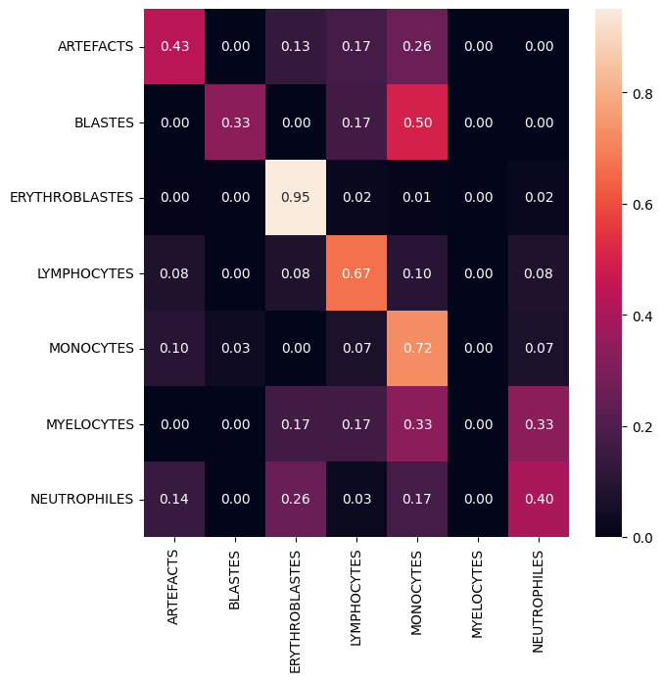
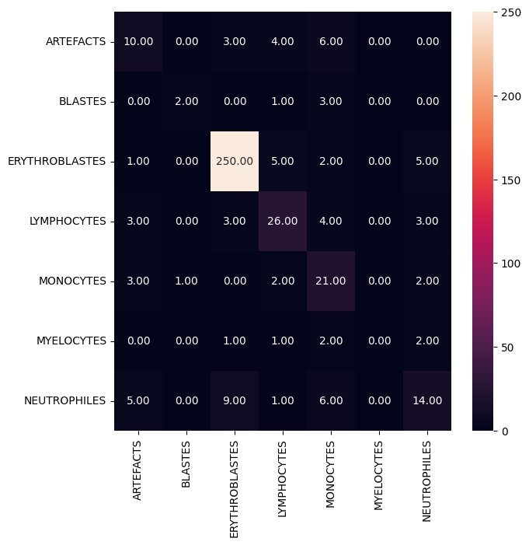
CONFUSION MATRIX
Visualises the predictions of the algorithm
Can be normalised or not
Normalized
Not normalized

Slide 19
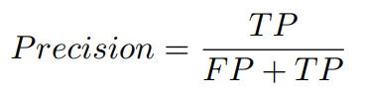
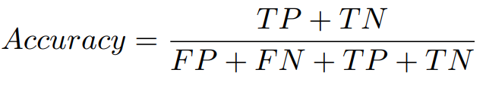
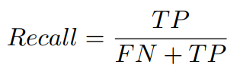
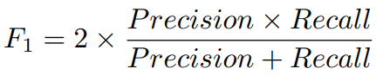
THE EXISTING METRICS

Slide 20





PRECISION GRAPE
Truth
Prediction
Precision = 3/4

Slide 21
ACCURACY GRAPE
Truth
Prediction
Accuracy = 7/9

Slide 22
RECALL GRAPE
Truth
Prediction
Recall = 2/3

Slide 23
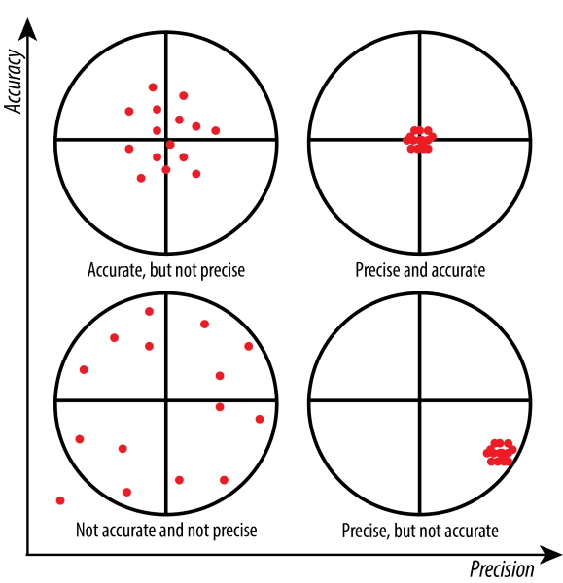
ACCURACY VS PRECISION

Slide 24
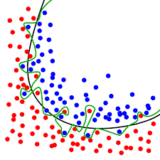
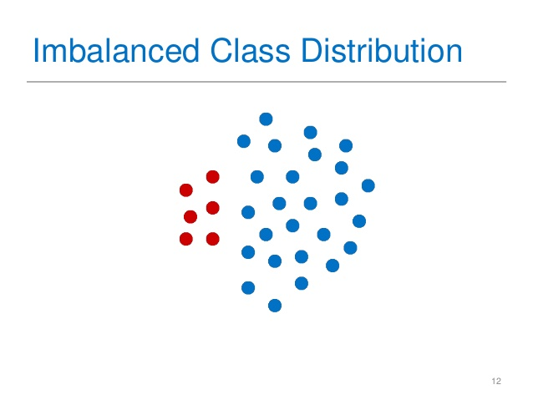
RÉDUCTION DE DIMENSIONALITÉ ET DÉSÉQUILIBRE DES CLASSES
Overfitting problems
Lazy algorithm
PCA, dimensionality reduction methods
Overfitting

Slide 25
THANK YOU

Slide 26
TP 2

Slide 27
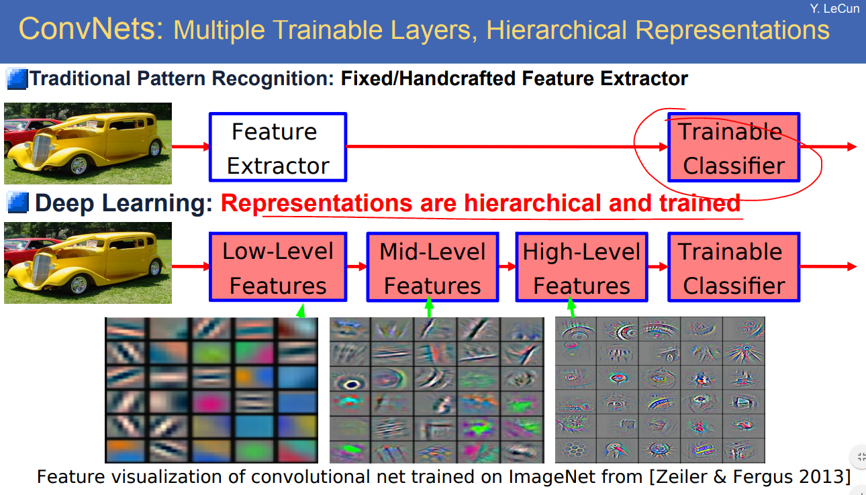
GOING FROM ML TO DL

Slide 28

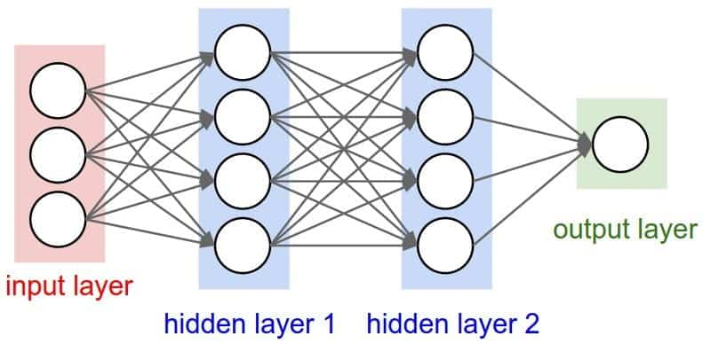
DEEP LEARNING FOR IMAGES: CONVOLUTIONAL NEURAL NETWORK
Neural network
Convolutional neural network

Slide 29
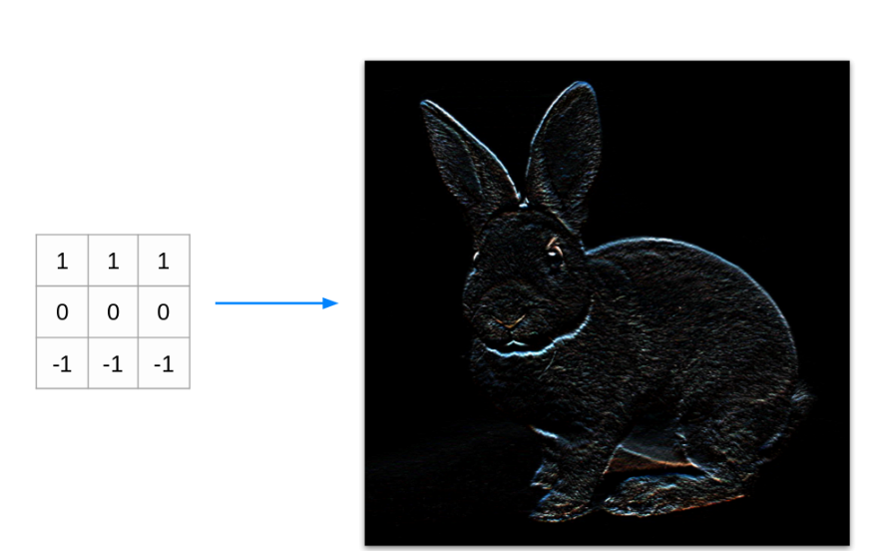
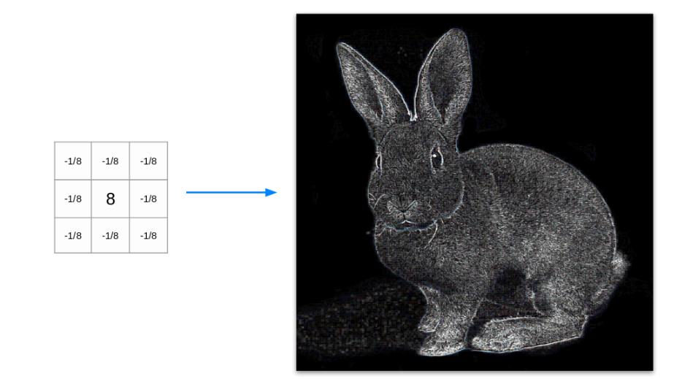
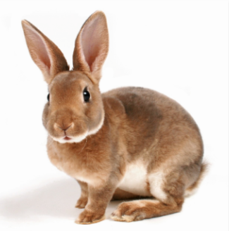
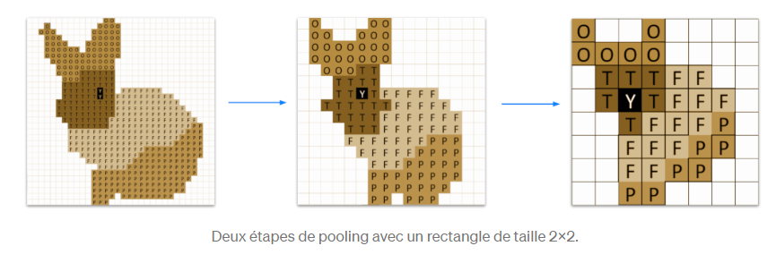
CONVOLUTIONAL AND POOLING LAYERS
Accentuates change of colours
Accentuates textures

Slide 30
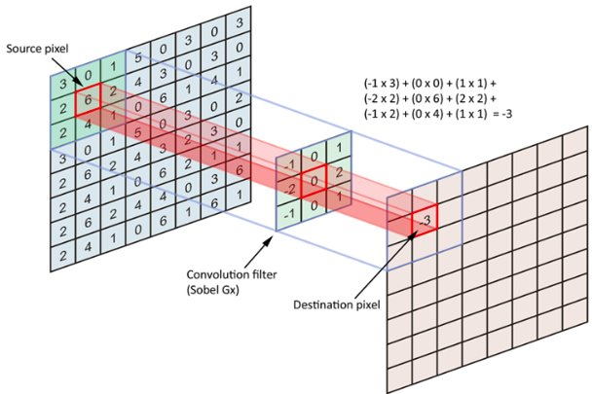

CONVOLUTIONAL AND POOLING OPERATIONS
Convolutional operation
Pooling (max) operation

Slide 31
THE PYTORCH WORKFLOW

Slide 32
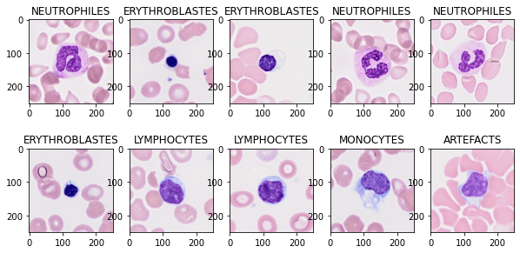
CREATE A DATALOADER
CPU: good memory but slow
GPU: fast but low memory
Send batches to the GPU until you've seen all the dataset
Example of one batch: batchsize=10

Slide 33
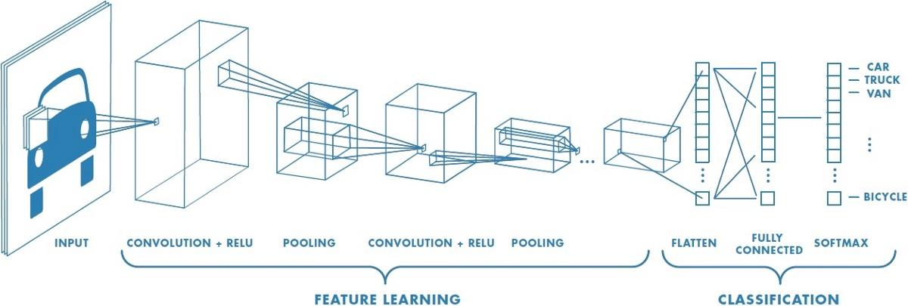
DESIGN THE MODEL ARCHITECTURE

Slide 34
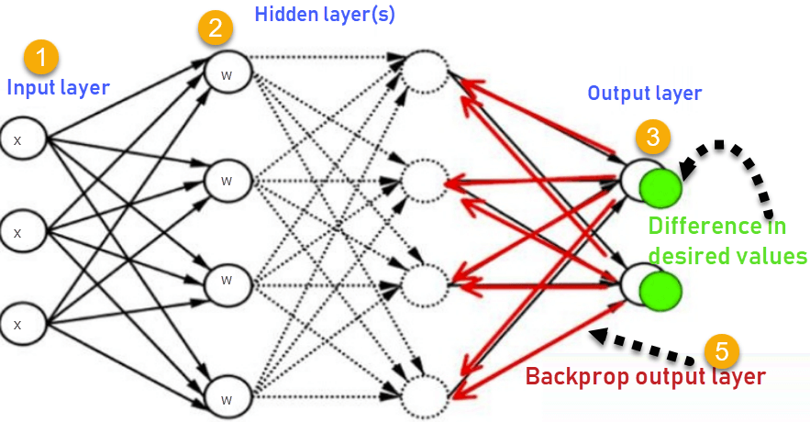


LOSS AND OPTIMIZER: BACKPROPAGATION
Loss function
Loss determines the error of the algorithm.
Reducing loss is the key to make network perform better.
Choose carefully the optimizer that reduces loss

Slide 35
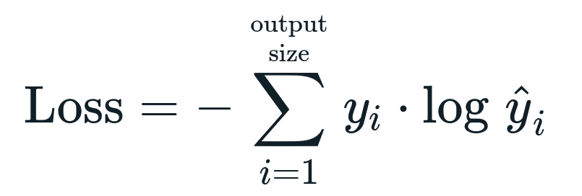
LOSS FOR MULTILABEL CLASSIFICATION
Categorical cross entropy

Slide 36
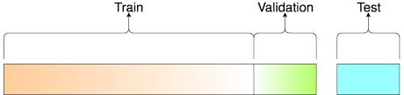
TRAINING YOUR MODEL
Train the model on the right number of epochs (one epoch = you've seen all dataset)
Evaluate the performances of the model on the validation set
When the optimal performance is reached, try again with other hyper parameters (batchsize, number of layers, number of nodes, optimizer...)
Evaluate the final best model on the testing set
Hyper-
Parameters
Tuning
Grid search

Slide 37
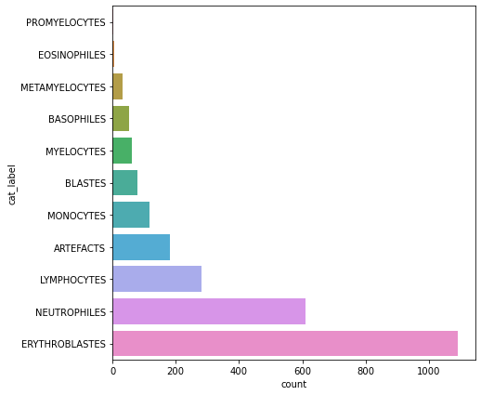
PROBLEMS TO OVERCOME
Class imbalance: algorithm is lazy and will learn about majoritarian class
Overfitting: model has a lot of parameters (millions)
-> We have only 3000 images

Slide 38
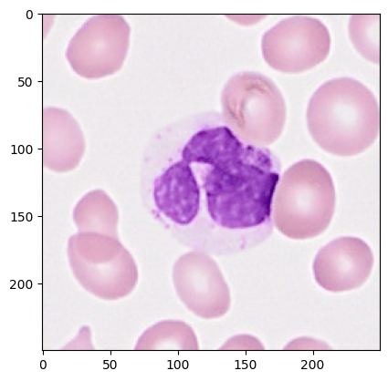
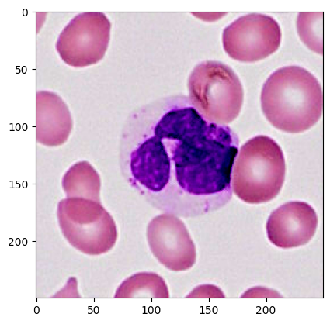
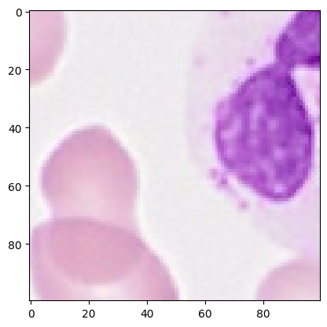
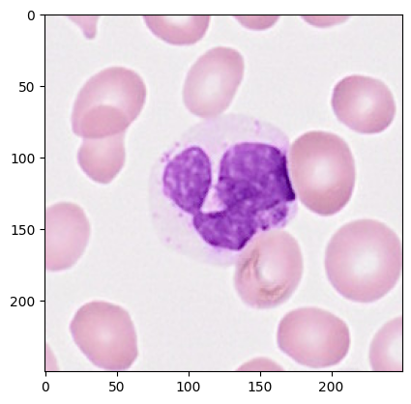

SOLUTIONS
Data augmentation
Sampler in dataloader
Pretrained neural network (transfer learning)

Slide 39
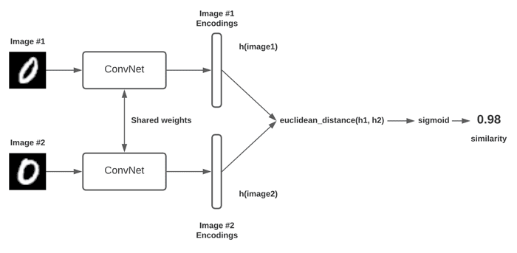
TO GO FURTHER
1. Siamese Neural network

Slide 40
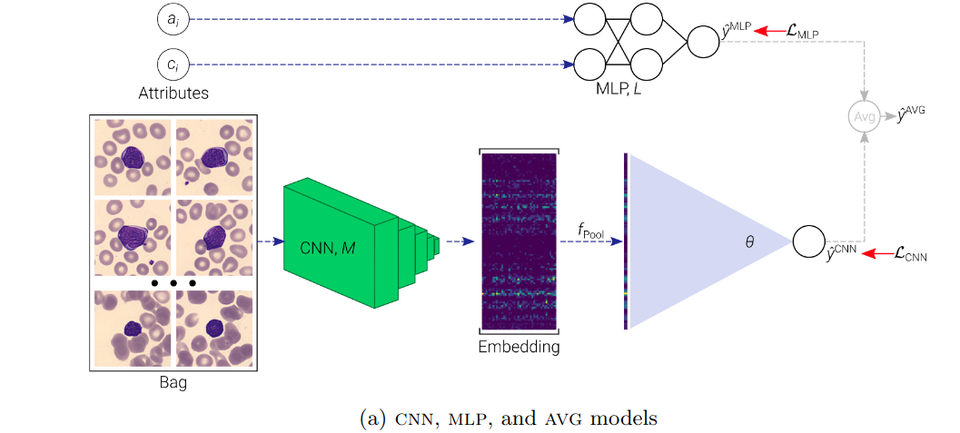
TO GO FURTHER
2. Integration of heterogeneous data

